Slide 1
Car Number Plate Detection Using MATLAB

Slide 2
Slide presentation by:
Pratik Sarkar (34900318046)
Subhankar Baidya (34900318023)
Subham Bagdi (34900318024)
Avradip Mondal (34900318069)
Dipankar Barman (34900318062)
Shis Hossain (34900318032)

Slide 3
INTRODUCTION:
With the increasing number of vehicle in today’s world it’s not possible to manually keep a record of the entire vehicle. There need to be a man standing 24*7 to note down the number. It’s a time consuming process and require manpower. Furthermore the data stored manually is not readable after a long time. So to overcome all these limitations here we tried to develop a system which would automatically detect the number plate and store it in its database. Later on when the information is required one can get it and use it.

Slide 4
Working Process Overview:
The process of working involves that as soon as the vehicle enters the secured area the system automatically captures the images and stores it. The processing of the image is done through the software stored in the system. If the vehicle matches the already stored information then it’s allowed to pass the gate. And if the vehicle is not recognized or if its marked in the blocked list then it’s not allowed to cross the gate and further checking process are followed. This process also helps to get the correct result compared to manually one.

Slide 5
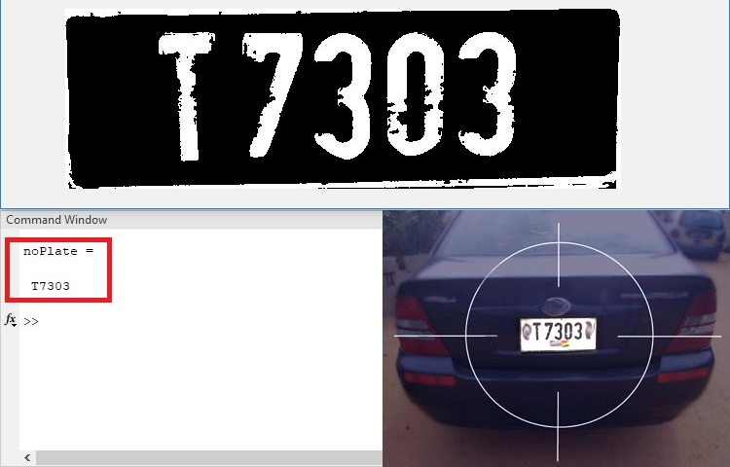
Pictorial Overview:
Image source: Google

Slide 6
PLATFORM DETAILS:
.
i) We are using MATLAB for this project.
ii) It solves technical computational problems faster than C,C++ and other programming languages.
iii) MATLAB is simple to use and it process still images and can create simulation videos easily.

Slide 7
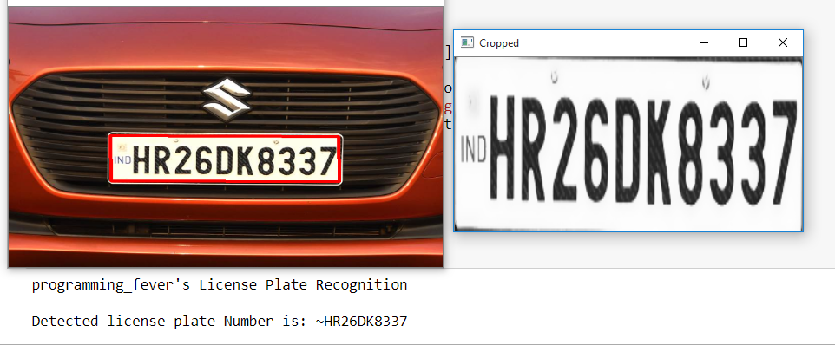
Technique Used:
We are using Image Processing technique in which captured image of the vehicle number plate is processed through multiple algorithms to convert the alpha numeric conversion of image into text format and displayed.

Slide 8
A brief about Image Processing:
Set of computational techniques for analyzing, enhancing, compressing, and reconstructing images. Its main components are importing, in which an image is captured through scanning or digital photography; analysis and manipulation of the image, accomplished using various specialized software applications; and output (e.g., to a printer or monitor).

Slide 9
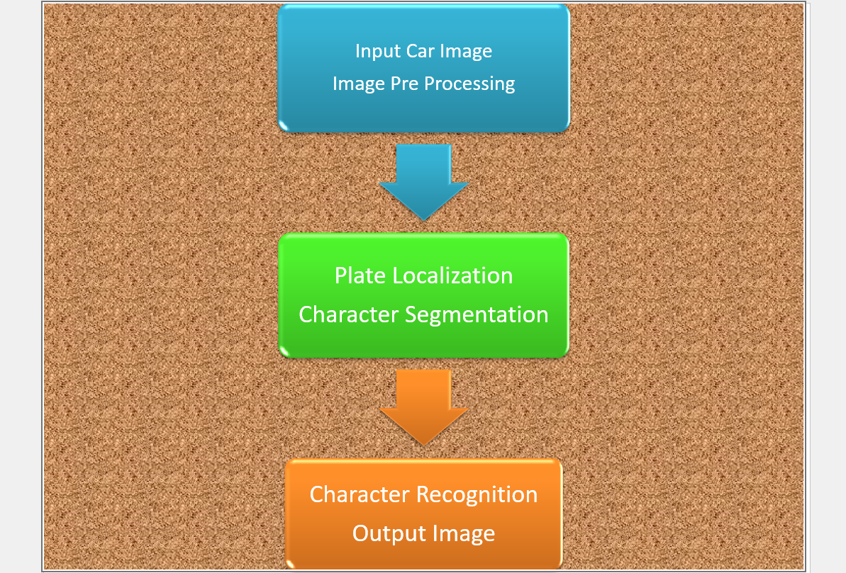
Working procedure of our Project:
Diagram source: Circuit Digest

Slide 10
Image Processing and Plate Localization:
Image is pre-processed through different algorithms and location of number plate is extracted. Major stages include:
RGB to GrayScale Conversion.
Detection of Plate Size.

Slide 11
(Continuation of previous slide):
3) Dilation of BGM(Binary Gradient Masking)
4) Media Filtering
5) Eroding of Image
6) Multiplication of segmented image with gray scale image.
7) Number Plate Image of Vehicle.

Slide 12
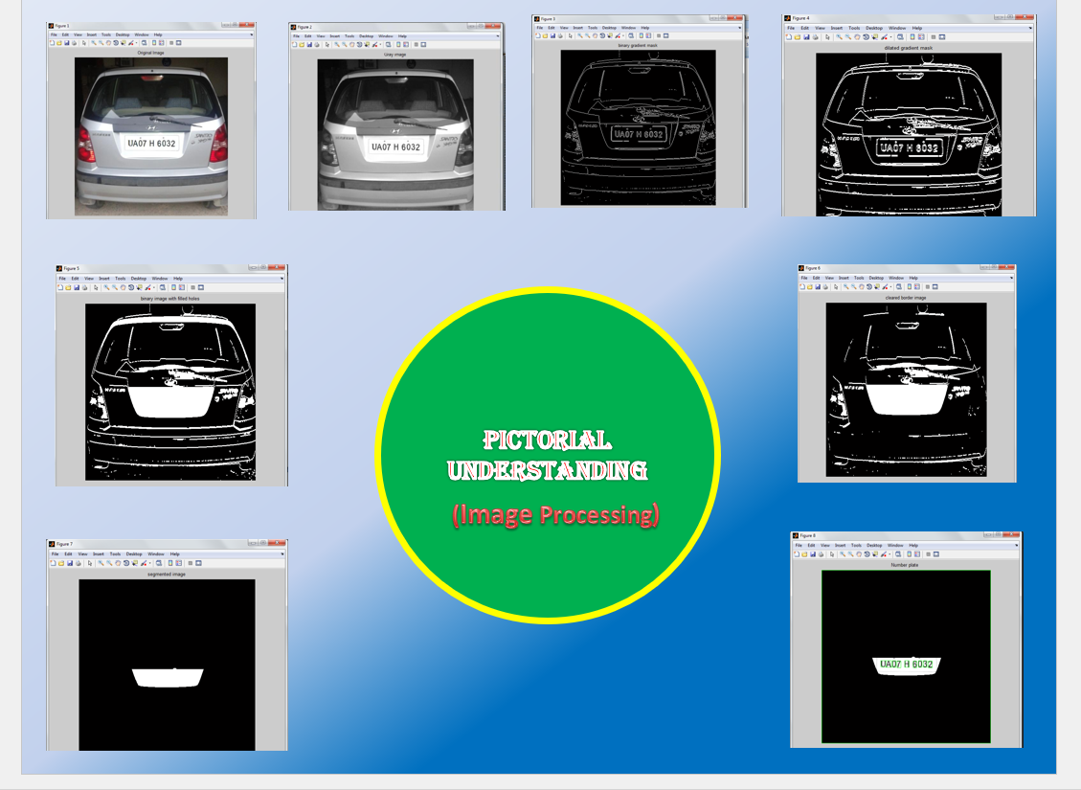

Slide 13
Character Segmentation:
Segmentation is one of the most important processes in the number plate recognition, because all further step rely on it.
We have used Bound Box Technique for the further proceedings.
-> Bound-Box Technique is discussed in the next slide.

Slide 14
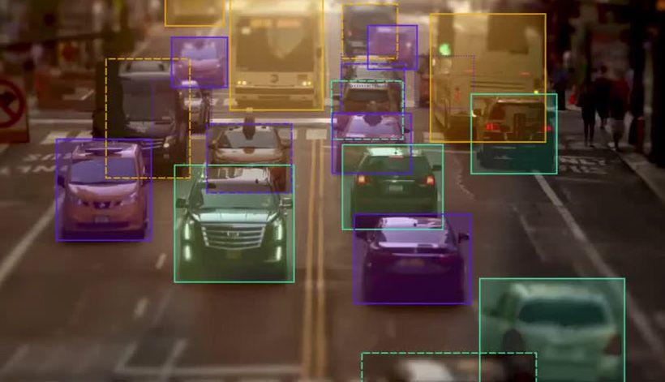
Bounding Box Technique:
It is used to measure properties of image region.
Once a Bounding Box is created over each character and numbers presented on number plate, each character & number is separate out for recognition of the number plate.

Slide 15
Character Recognition:
Number plate recognition is now used to compare the each individual character against the complete alphanumeric database using template matching.
After successful and accurate template matching, text file of output image is displayed.

Slide 16
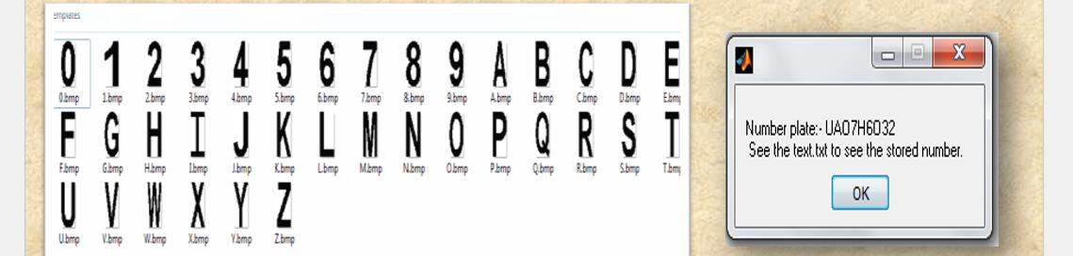
Character recognition Diagram:
Image source: Google

Slide 17
Important MATLAB Functions and Formula used:
1 gray = 0.114*R+0.587*G+0.299*B
I= rgb2gray(RGB) converts the true color image RGB to the grayscale intensity image I.
BW2 = imfill(BW, ‘holes’) fills holes in the input binary image BW.

Slide 18
(Continuation of previous slide):
imclearborder (I): It suppresses structures in image I that are lighter than their surroundings and that are connected to the image border.
imread(filename): It reads the image from the file specified by filename.

Slide 19
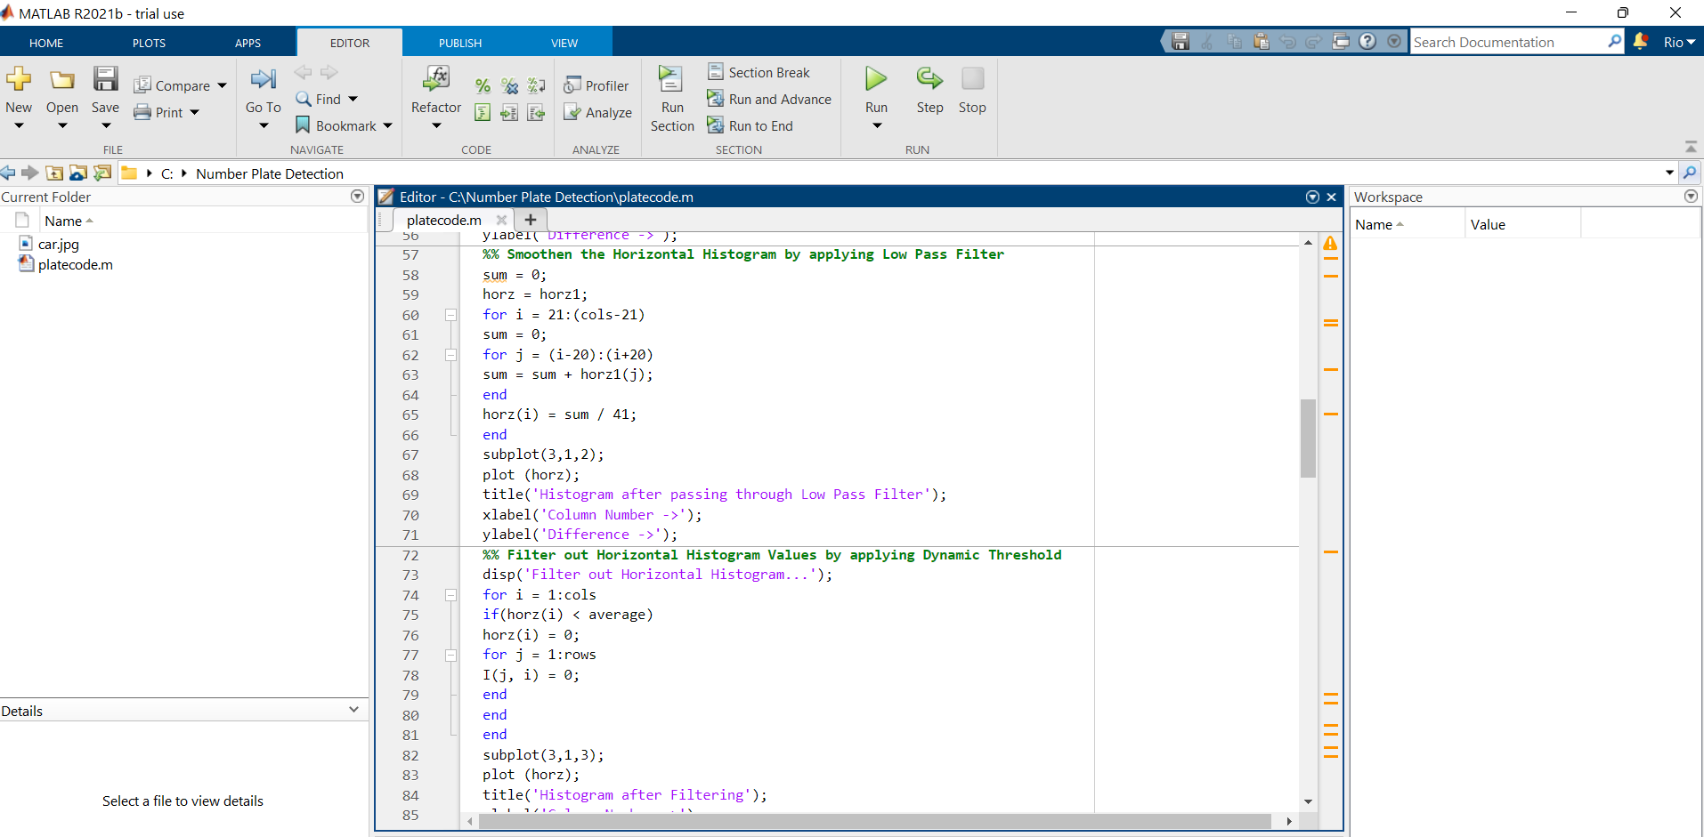
Code of our Project:

Slide 20
Applications:
Parking : Allow to enter prepaid members.
Tolling : Calculate travel fee in toll road and used to double check ticket.
Border Security: Monitors inter as well as intra crossing of vehicles.

Slide 21
Continuation:
-> Traffic Control: Directed to different lanes.
-> Airport Parking: Reduce ticket frauds and captures image of car and number plate.

Slide 22
Limitations:
Broken number plates.
Blurry images.
Number plate not within the legal specification.
Low resolution of characters.

Slide 23
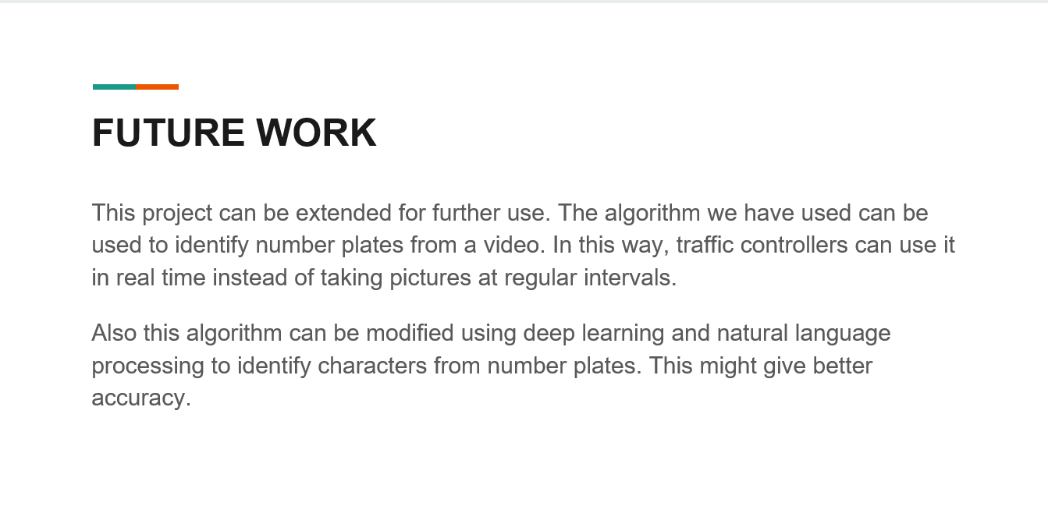

Slide 24
Conclusion:
We have implemented number plate recognition. Our algorithm successfully detects the number plate region from the image which consists of vehicle number & then character segmentation, recognition .We have applied our algorithm on many images and found that it successfully recognition. The project was designed keeping in mind the automation of the number plate detection system for security reason that could replace the current system of manual entry. This project was a success in recording the number plate of a vehicle although it has got its own limitation of image processing and other hardware requirements.

Slide 25
Acknowledgement
It is our pleasure to acknowledge our supervisor Dr. Sourish Sanyal Sir, our beloved mentor, Head Of the Department, Training and Placement Officer(Officiating), Coochbehar Government Engineering College,Coochbehar, for being not only the source of encouragement, but also great resource of knowledge and information. We shall remain indebted to him for the immense help we have received from him.
We would also like to thank all the faculty members, technical assistants and staffs of the department of Electronics and Communication Engineering, for their kind and friendly cooperation extended to us.
We have no appropriate words to express sincere thanks to our family members for their continuous support and encouragement.

Slide 26
References:
https://circuitdigest.com
https://github.com/achalesh27022003/Number-Plate-Detection
https://www.youtube.com/watch?v=p_g-g7C3uHw&t=6s
Image and Diagram sources: Google

Slide 27
THANK YOU!
Students, Department of Electronics and Communication Engineering,CGEC.

